Slide 1
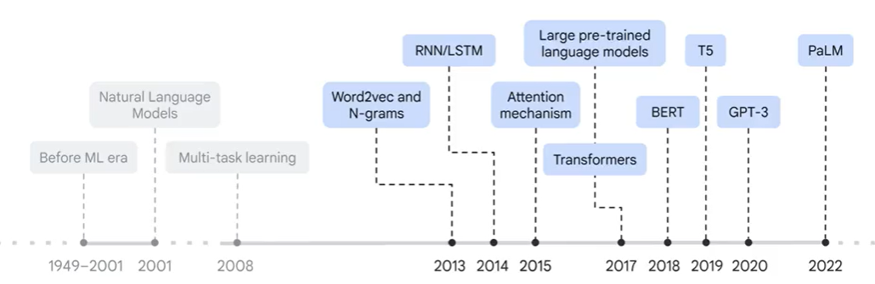
Marya Butt, PhD.
Researcher Data Driven Smart Society (DDSS)
BIG DATA, Computer Vision, Machine Learning
Faculty of Engineering Design and Computing
Mob: +31(0) 0611878759
E: marya.butt@Inholland.nl
Deep Learning
LLM, Vision Transformers(ViT)

Slide 2
Large Language Models (LLM)
Neural Network designed to understand, generate, and respond to human-like text
Deep Neural Networks trained on massive text data

Slide 3
Why LLM?
Traditional models struggle with context dependence, whereas the Transformer model, through its self-attention mechanism, processes the entire sentence, making it significantly more effective at understanding context
For example, in the sentence: “XYZ went to France in 2019 when there were no cases of COVID and there he met the president of that country,” the word “that country” refers to _________________
Traditional Models (e.g., RNN) would struggle to link “that country” to “France” since RNN processes each word in sequence, leading to the loss of context over long sentences.

Slide 4
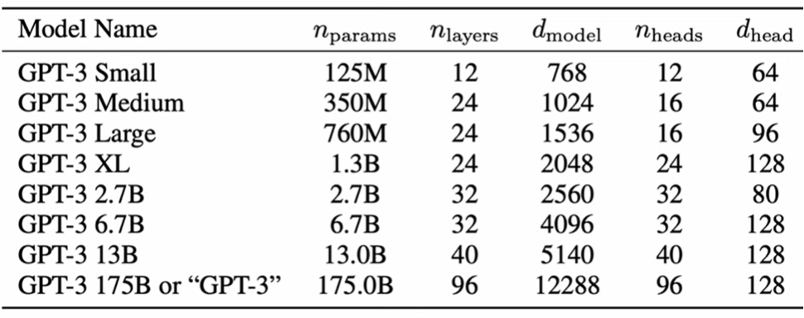
Large Language Models (LLM)
Models have billions of parameters!

Slide 5
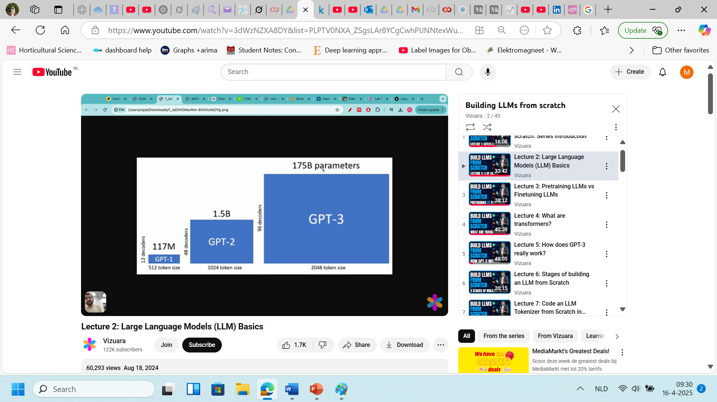
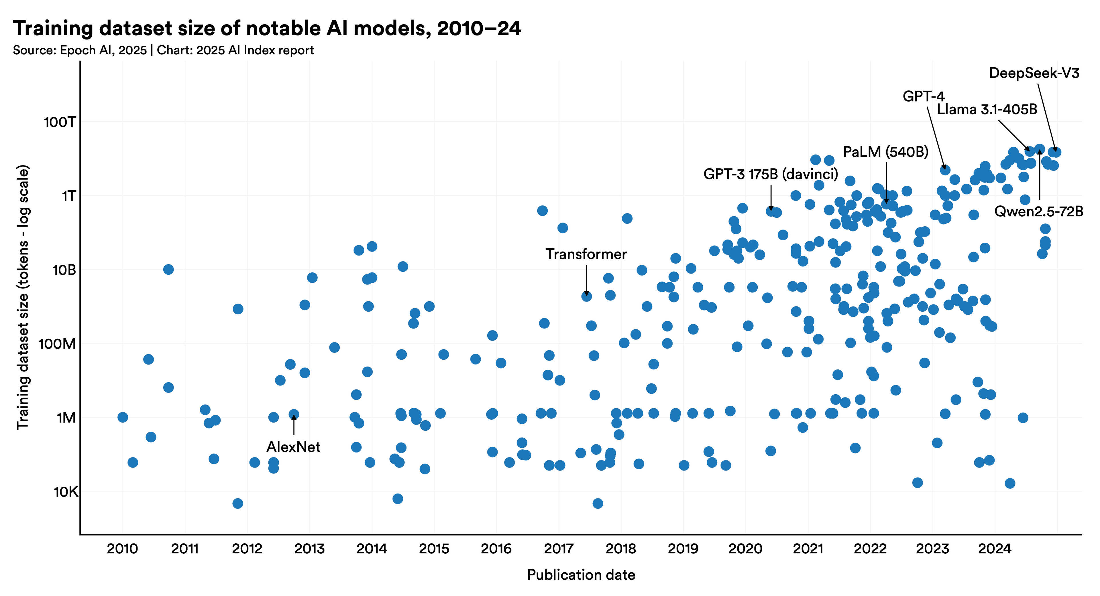
Large Language Models (LLM)
Models have billions of parameters!
NLP tasks, e.g., question, answering, translation, sentiment analysis, etc.

Slide 6
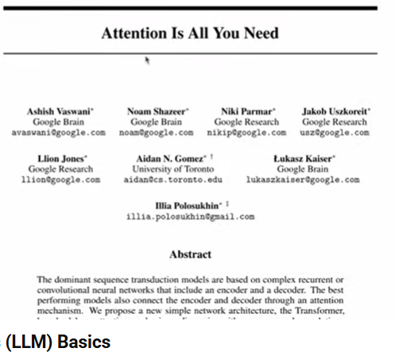
LLM vs earlier NLP Models
- LLM can do a wide range of NLP tasks
- While earlier NLP models are designed for specific tasks, e.g., language translation, sentiment classification, etc.
For example, writing an email from custom instructions is much harder to do with traditional NP models; however, it is very basic for LLMs
What makes LLM so good?
TRANFORMERS

Slide 7
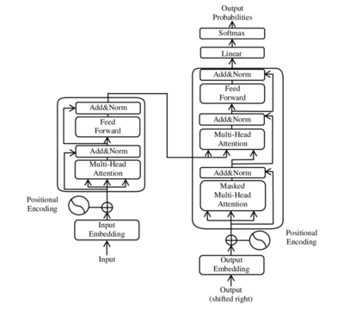
Large Language Models (LLM) TRANSFORMERS
ENCODER
DECODER
The encoder-decoder structure is key to transformer models.
The encoder processes the input sequence into a vector
The decoder converts this vector back into a sequence.

Slide 8
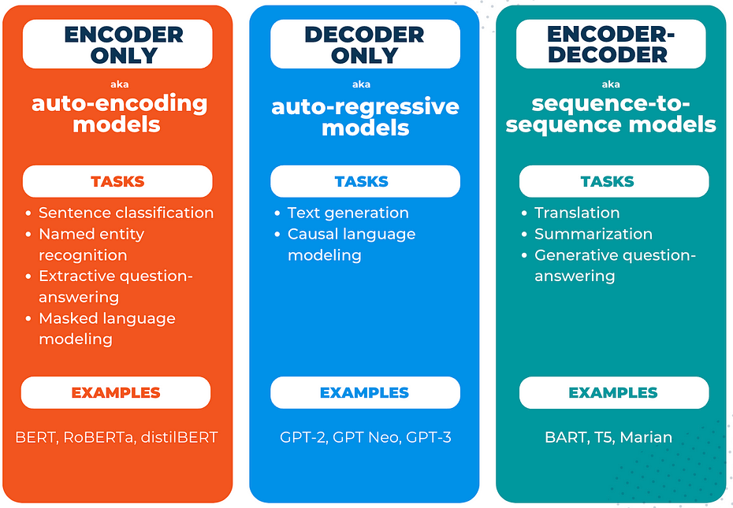
Transformer (Variants)

Slide 9
Applications of LLM (Guess the LLM Variant)
Chatbots/Virtual Assistants
Machine translation
Novel Text Generation
Sentiment Analysis
Content Creation

Slide 10
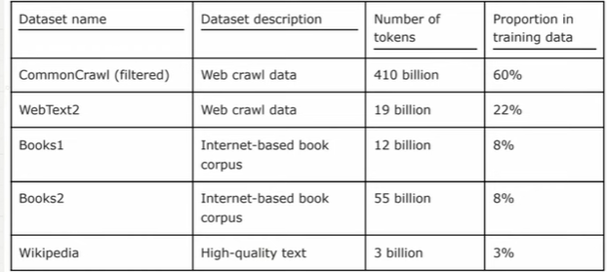
Stages of Building LLM
Creating an LLM= Pretraining Vs Finetuning
PRETRAINING
Training on a Large, diverse dataset
FINETUNING
Refinement of training on a narrow dataset for a particular task or domain
Internet texts, books, media, research, articles
train
Pretrained LLM
(Foundational Model)
train
Classification
Summarization
Translation
Personal Assistant
Raw unlabelled text (trillions of words)
LLM pretrained on unlabelled text data
(fintuned LLM on labelled data)

Slide 11
Steps for building LLM
Train on a Large corpus of raw data. (regular text without any labeling)
The first training stage of an LLM is called pretraining, which creates an initial foundational model, e.g., GPT-3 is a pretrained model capable of text completion.
After getting the pretrained model, LLM can be further trained on labelled data.
There are two popular types of finetuning, i.e., instruction finetuning and finetuning for classification tasks.
Labelled data consists of instruction-answer pairs, e.g., airline customer support.
The labelled dataset consists of text and associated labels, e.g., emails (spam vs non-spam)
Notes:
Fir

Slide 12
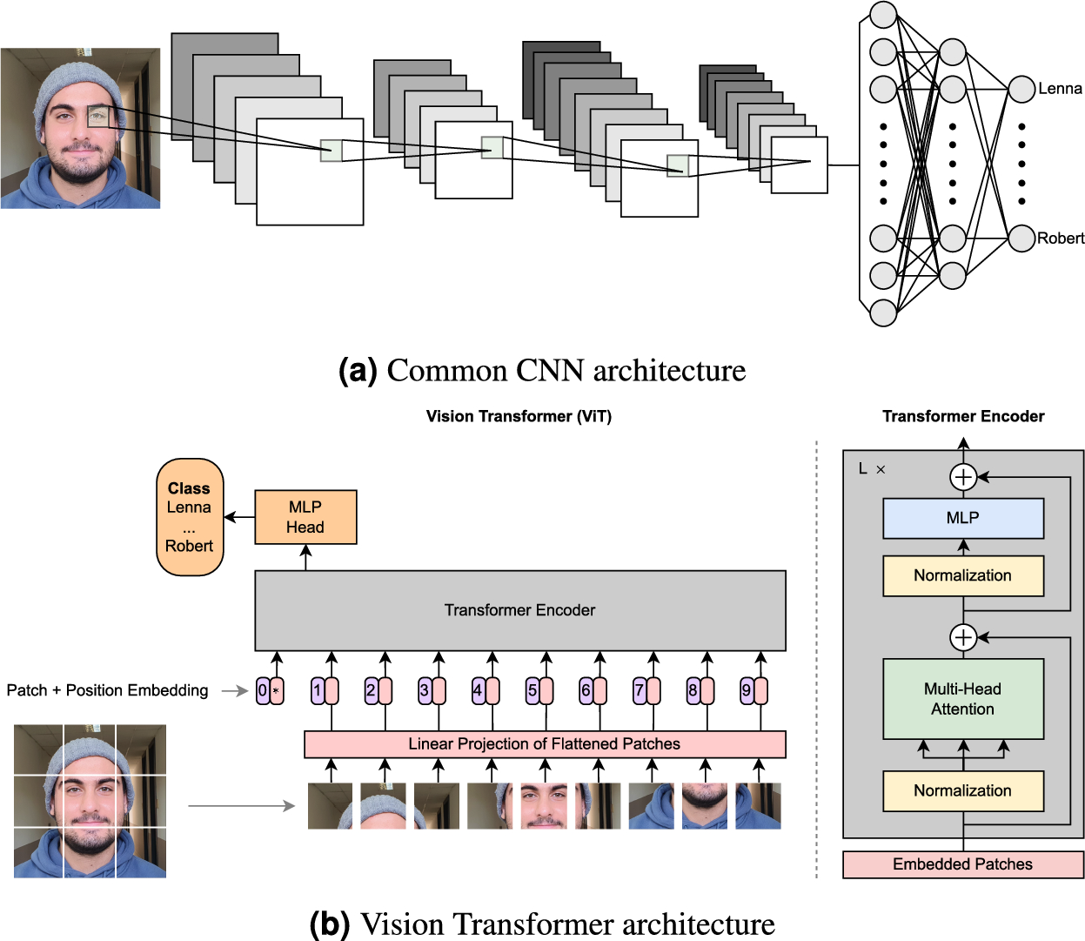
From CNN to ViT
Notes:
Source: Comprehensive comparison between vision transformers and convolutional neural networks for face recognition tasks | Scientific Reports

Slide 13
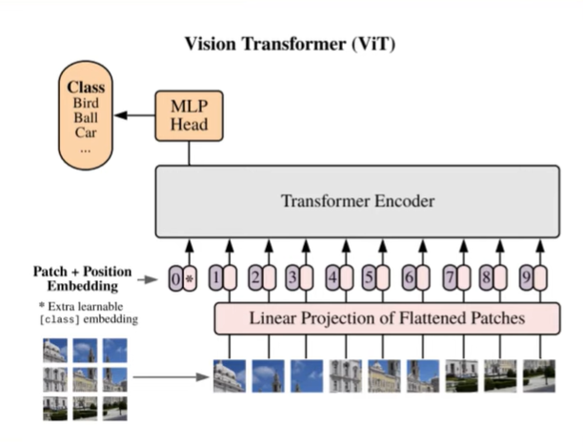
Vision Transformers
Self-attention in computer vision allows the model to understand the relationship between the different parts of the image by assigning importance scores and focusing on the most relevant information.

Slide 14




Vision Transformers

Slide 15
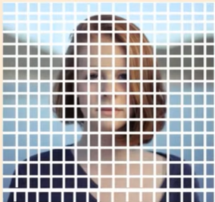
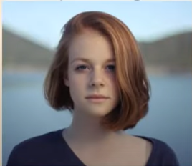
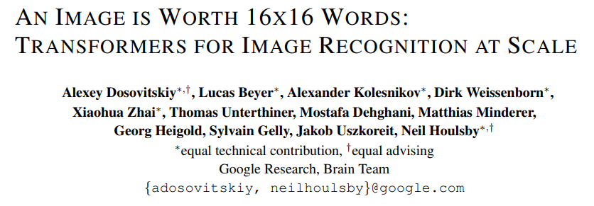
Vision Transformers
Ìnput Image (224 x 224)
No. Of Patches= (224/16) * (224/16)
= 16 * 16
= 196 Patches
Stride =16

Slide 16
Vision Transformers
No. Of Patches= (224/16) * (224/16)
= 16 * 16
= 196 Patches
Flatten the patches from 2D to 1D
2D
1D
Assuming an RGB Image,
Each patch has the size of (16x16x3)

Slide 17



Vision Transformers
process information as a sequence of elements, namely TOKENS
1 patch
1D
Assuming an RGB Image,
Each patch has the size of (16x16x3)
.
.
1 patch= 16x16
= 256 tokens

Slide 18
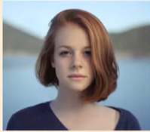
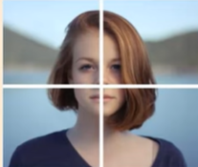
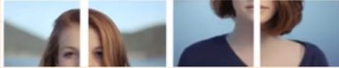
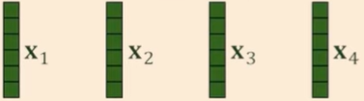
Vision Transformers (Encoder-only Transformers)
32x32
4 patches of size 16x16
Why Encoder-only?
Because their main goal is understanding the entire image, not generating a new image or sequence, just like how BERT is used for language understanding, not generation.
2D
X1
X2
X3
X4
1D
256 tokens
256 tokens
256 tokens
256 tokens

Slide 19
Vision Transformers (Encoder-only Transformers)
32x32
4 patches of size 16x16
2D
X1
X2
X3
X4
1D
256 tokens
256 tokens
256 tokens
256 tokens

Slide 20
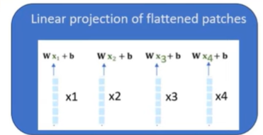
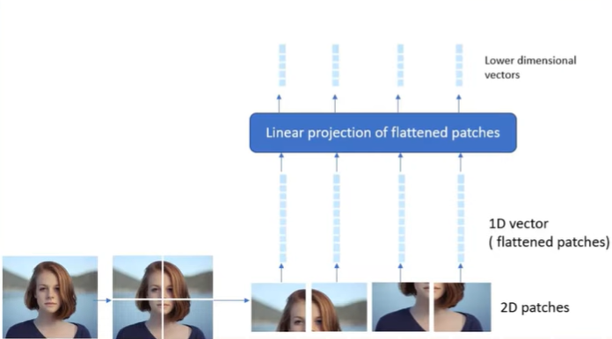
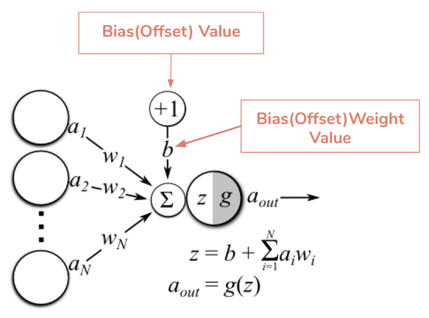
Vision Transformers (Encoder-only Transformers)
128
Linear Projection involves
Weight Matrix Multiplication
Bias Addition
256

Slide 21
Vision Transformers (Encoder-only Transformers)
128
Linear Projection involves
Weight Matrix Multiplication
Bias Addition
256

Slide 22
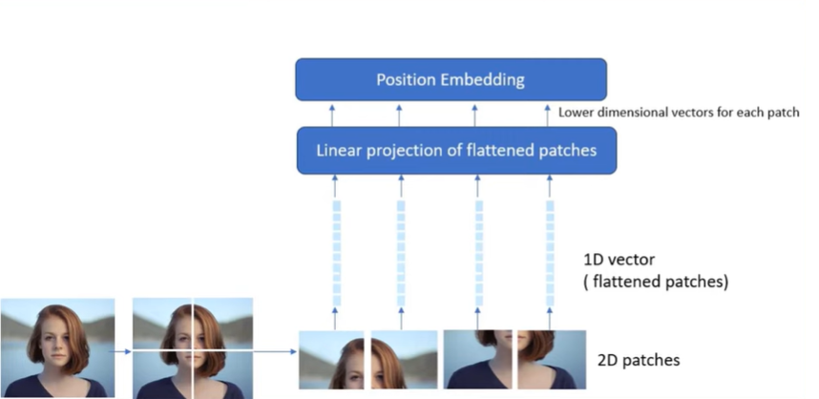
Vision Transformers (Encoder-only Transformers)
Why Positional Embedding?
As it adds positional information to tell the model:
“This patch came from the top-left… this one from the center… etc.

Slide 23
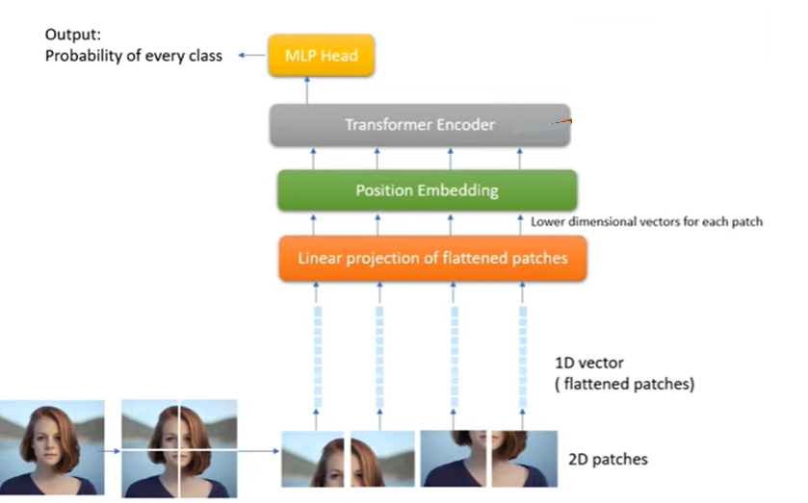
Vision Transformers (Encoder-only Transformers)
Transformer Encoder
Multi-Head Self-Attention
Allows each patch to "look at" all others to learn global relationships
Feed-Forward Network (FFN)
Applies non-linear transformations to enrich representations
LayerNorm & Residuals
Help stabilize and speed up training
The encoder learns:
How patches relate (e.g., edges, textures, shapes)
Global context (not just local like CNNs)

Slide 24
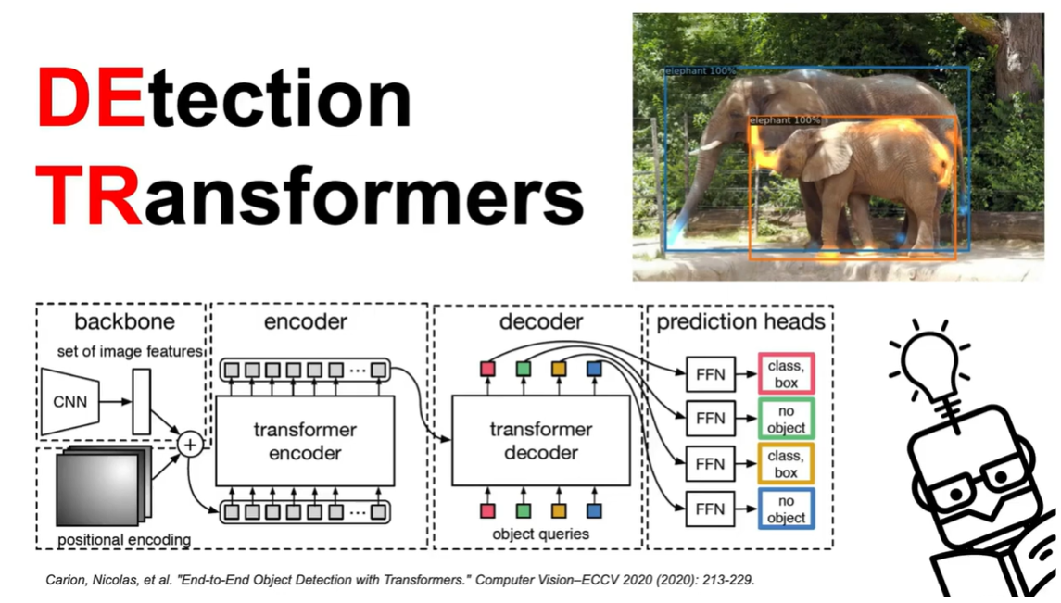

Slide 25
Detection Transformers (Training on Custom dataset)
How to Train DETR Object Detection Transformer on Custom Dataset

